Slide 1
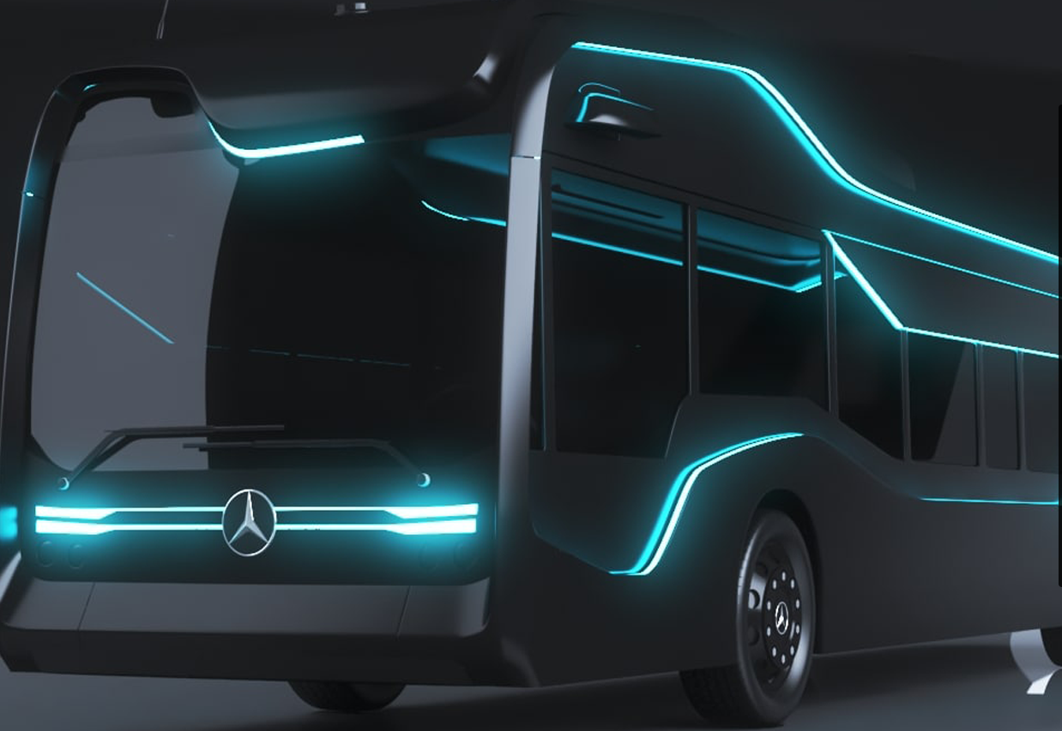
PLA Recall –User Manual
October 2020
Version 1.0

Slide 2
Recall Overview
Introduction
System walkthrough

Slide 3

Introduction
The recall module is another, if not the most, important part of the PLA system. A recall has to be created whenever any produced/assembled part doesn't meet the high quality standards at Mercedes-Benz.
If a problem is discovered during the manufacturing/assembly process and/or an external vendor informs the manufacturing-/assembly department about defective or suspiciously defective parts, the PLA-System is used to identify all suspicious parts and to inform the attached systems about the issue.
This has to be done to prevent defective units being sent to the car assembly plants.
Every recall can be generally split into these steps (depending on the recall type some differences may apply, but not many):

Slide 4
Introduction
Select suspicious parts by using the search module, importing a list of suspicious IDs, creating a preventive recall or setting up a machine recall. Already created recalls can be extended by the same mechanisms.
Selected parts and attached parts (which might inherit the recall) are put together into a recall.
Basic recall data has to and extended recall data can be added to the recall.
Attached systems which have to be notified have to be added to the recall.
The recall is SET, which means that the attached systems are notified about the recall. Communication with the attached systems is managed by the loader process and is not in the focus of the recall module.
The blocked parts (blocked means that a part is not allowed to leave the plant) are processed and either fixed or wrecked. Fixed or unsuspicious parts are then reset within the recall to a non-blocking state and can then be shipped to the car assembly plant.
When all parts are reset to a non-blocking state, the recall can be closed by the PLA-RecallUser and the Recall-Lifecycle ends.

Slide 5
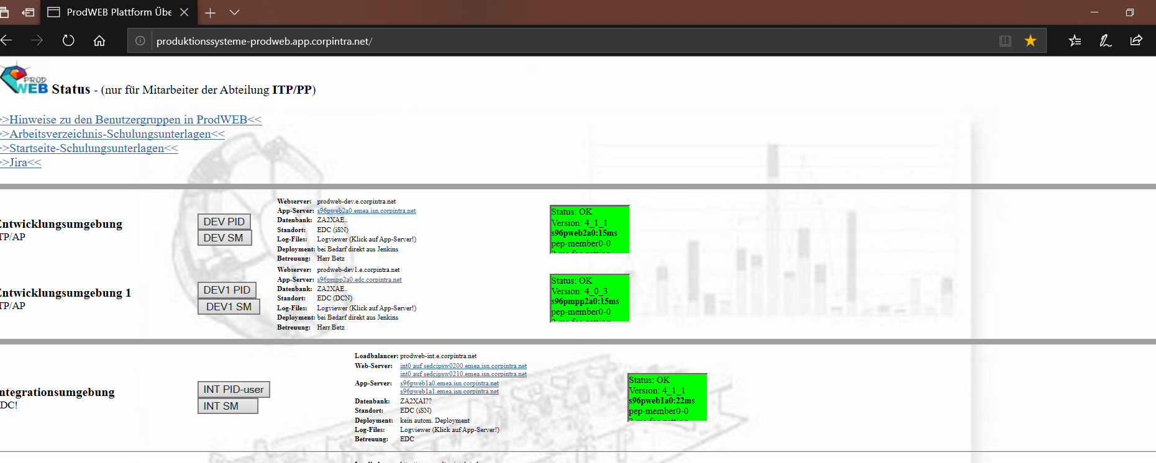
Initiation
Navigate to http://produktionssysteme-prodweb.app.corpintra.net/.
Click on Dev1 SM and Enter your credentials
Click on DEV1 SM

Slide 6
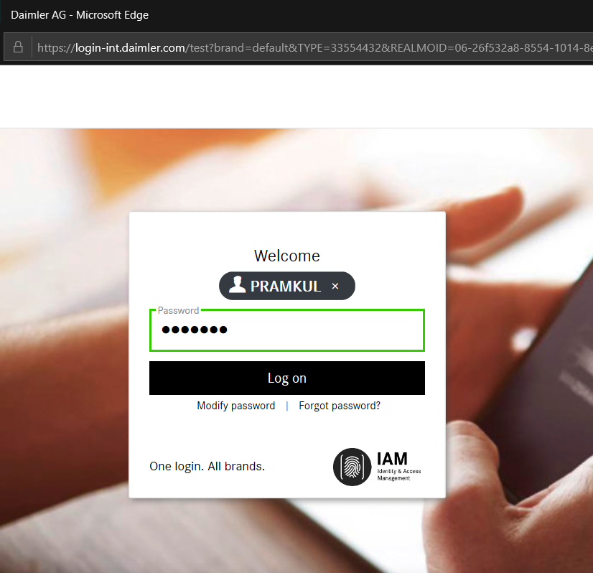
Initiation
Enter valid user name and password and Click on Log on button
Enter the Login credentials
Click on Log on

Slide 7
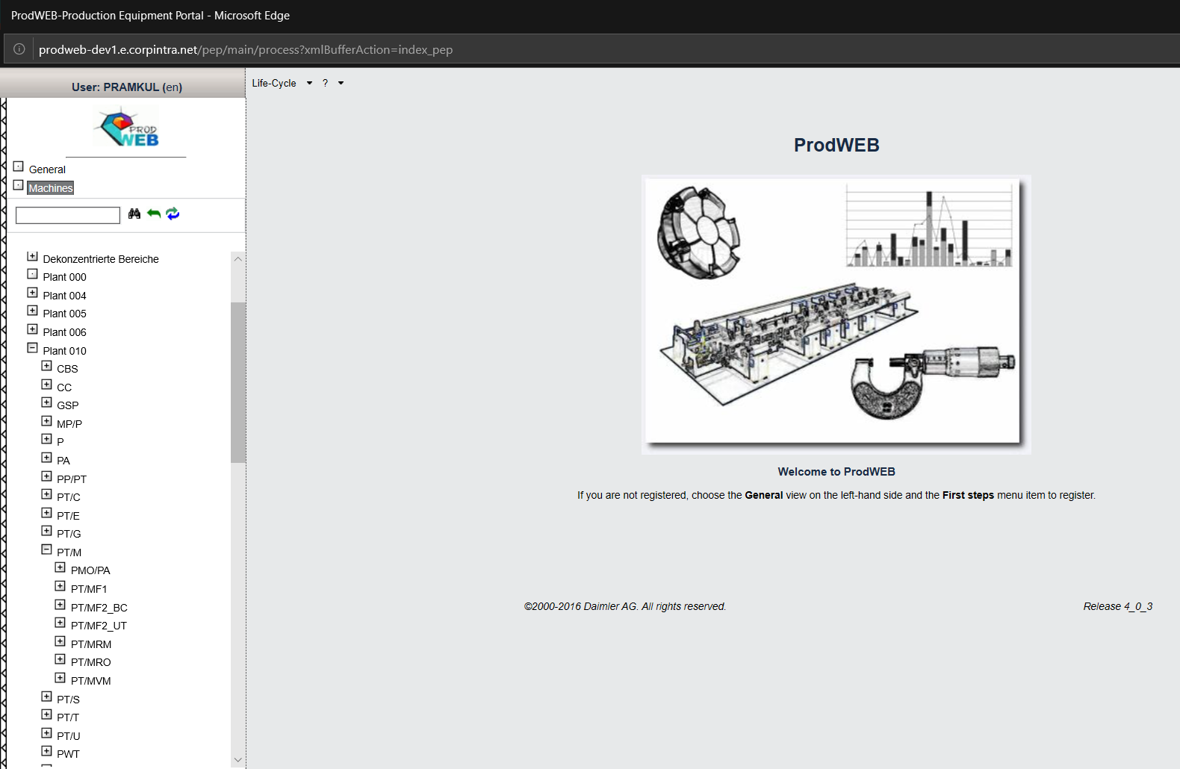
Home Page-Prod web tree
On Click of login button Prodweb page is displayed.
PLA user can select respective Plants and Cost center and access the PLA application
Plant 10 points to Plant Untertürkheim
To select particular node navigate from Machines->Plant 10 →Production Engines[PT/M] → PT/MVM
PT/M Consists of Production Engine information
All Engine Component Manufacturing information is present in node PT/MF2_UT

Slide 8
Content
System Tutorial

Slide 9
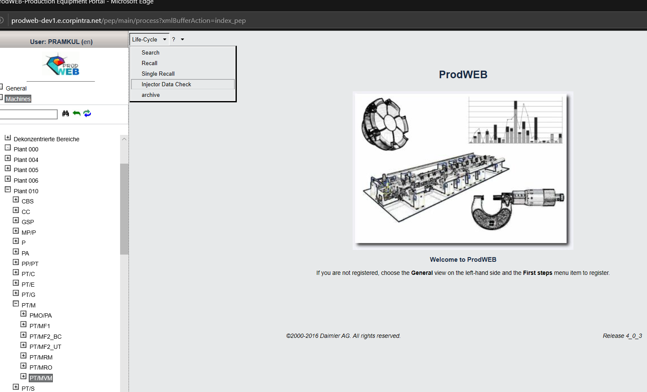
System Tutorial Navigation
PLA-User can access any module based on the rights assigned to each user. On Click of Recall module,Recall page will be displayed
Life Cycle Menu bar Consists of 5 modules. Search, Recall, Single Recall, Injector data check and archive
MBRDI is only responsible for Search, Recall, Single recall and Injector Data check. Archive is not in the scope of MBRDI.

Slide 10
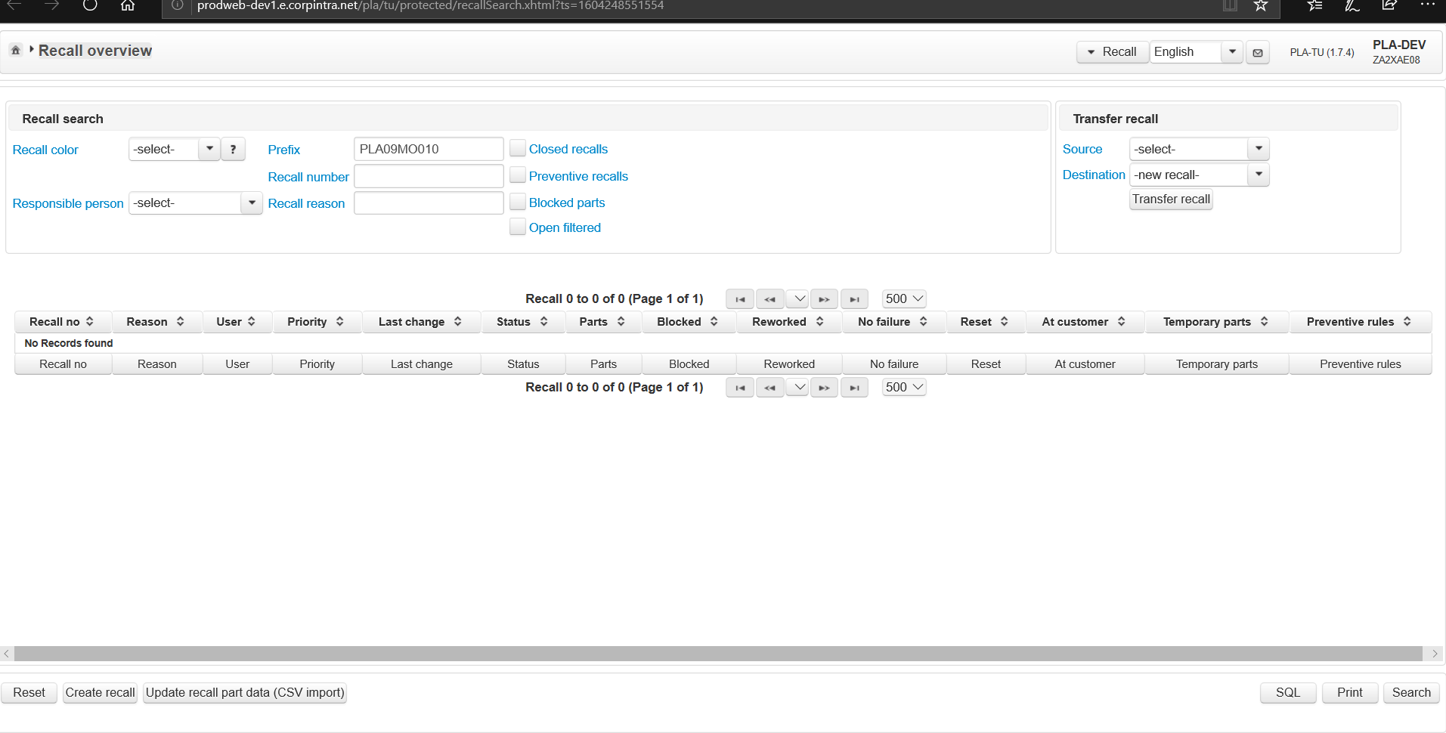
Recall Overview Screen
This is the main /overview page of the recall module. PLA-RecallUser can search, open, create, transfer and update (via CSV import) recalls.

Slide 11
Click on create recall button
Click on Create Recall button

Slide 12
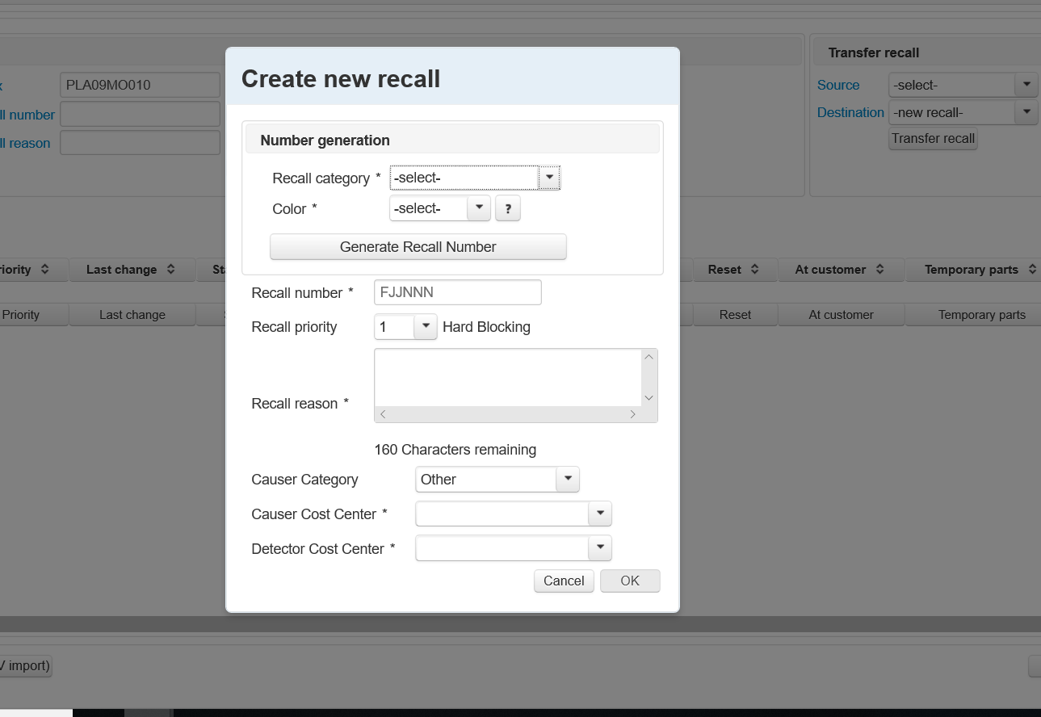
Click on create recall button
Create recall dialog is a modal dialog. Recall number can be generated here using recall category and Color. A recall has to have a unique number. It's either generated by PLA-System or given by the PLA-RecallUser.

Slide 13
Recall Category
A recall category is configured by a key/value pair in the table PLA_CONFIG.CFG_PLA_WEB.
The prefix of every category's key is:
recall. Category.
followed by a 2 character string to identify the category.
So, to identify 'WI' as a category, the key would be: recall.category.WI
The CFG_VALUE holds a string with all (recall-)colors, associated to this category, separated by a comma.
e.g. 'B,K' for category WI
The key is also used in the LBL_PLA_WEB for localized description of each category.
Query to fetch recall category values :
SELECT LBL_EN FROM PLA_CONFIG.LBL_PLA_WEB WHERE LBL_KEY='recall.category.SA' OR LBL_KEY='recall.category.IK' OR LBL_KEY='recall.category.QS' OR LBL_KEY='recall.category.WI'
special recall, inside Powertrain, inside cost center and outside Powertrain .

Slide 14
Recall Colors
Clicking on the ?-icon next to the color select-box displays a a tooltip with more information about recall colors. Values for this pop-up have to be localized and are provided in the LBL_PLA_WEB table, identified by the recall.color. keys.
value desc
P press
B blue (inside Powertrain)
R red (special recall)
G green (special recall)
W automatic recall
I inside cost center, no color
K no color (inside Powertrain)
O orange (outside Powertrain)

Slide 15
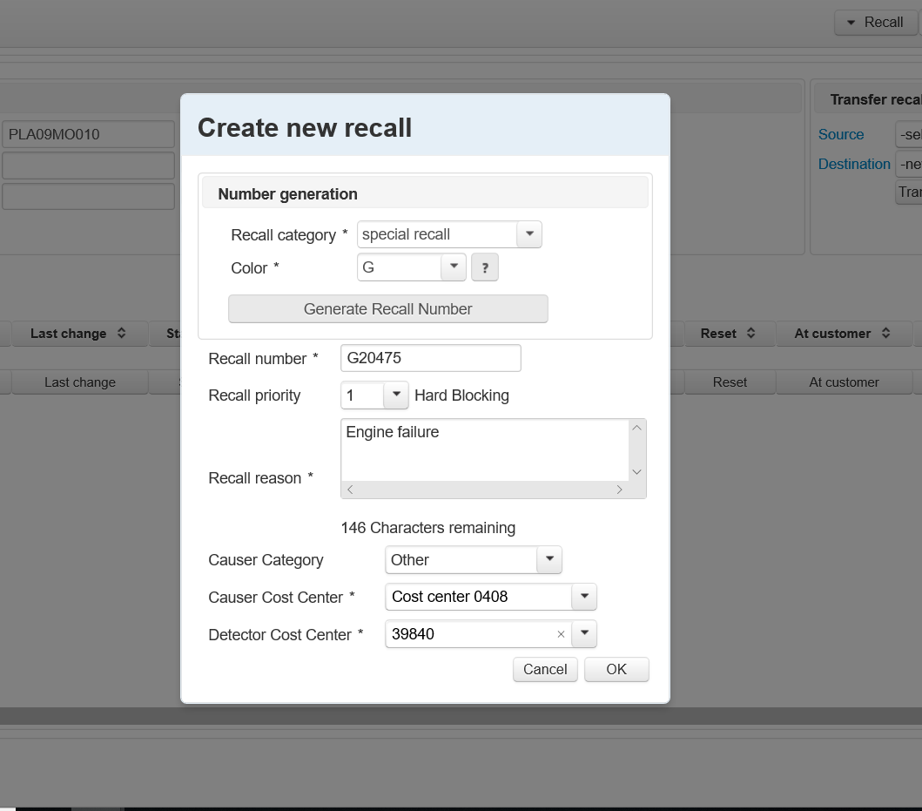
Generate recall number
Select Recall Category and Select Recall color and Click Generate recall number. Unique recall number should be generated. Recall reason is Mandatory field.
.
Select Causer and Detector cost center and Click OK button

Slide 16
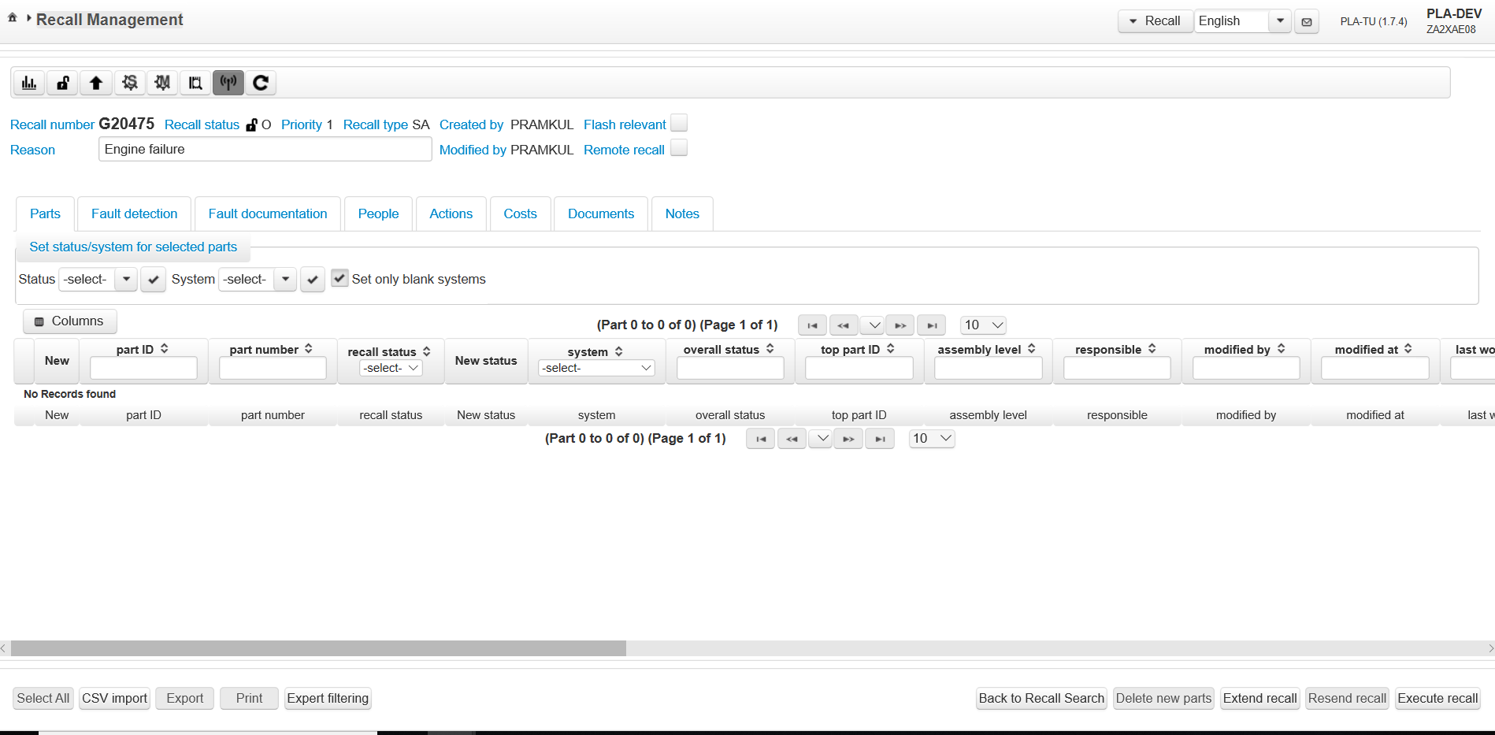
On Click of OK button inside Create recall dialog
Empty recall is created with no parts added. All the recall number can be seen here like Recall number, Recall status, Priority ,Recall type and Created by and Modified by
.
This buttons are called top level buttons and no colors are displayed. Top level buttons consists of Recall Statistics, Close recall, Top level button, Recall Stations,Recall Machines,Recall Preventive rules,Transmission Status and Refresh Transmission status
When empty recall is created,Delete new parts, Resent, Print and Export recall is disabled.

Slide 17
About Create recall
"When recall is created few set of information is inserted into DB.Open the Db and verify if data is inserted into that particular table.The entry in ST_ATE_AKTION_TEIL is not present when we perform recall creation from recall over view page.
INSERT INTO ST_AKT_AKTIONIERUNG (AKT_AKTION_NR, AKT_DAT_HIST, AKT_SYSTEM, AKT_AKTIV_KZ, AKT_LOAD_DATE, AKT_AKTION_TEMP, AKT_AKTION_STATUS, AKT_FEHLER_ERKANNT_TAGSTEMPEL, AKT_RUECKLIEFERUNG, AKT_SPERREMPFEHLUNG) VALUES (new recall number, CURRENT_TIMESTAMP, 'PLA', '1', CURRENT_TIMESTAMP, '0', 'O', CURRENT_TIMESTAMP, '0', '0');
INSERT INTO ST_AKF_AKTIONIERUNG_FEHLER (AKF_AKTION_NR) VALUES (new recall number);
INSERT INTO ST_AKM_AKTIONIERUNG_MASSNAHMEN (AKM_AKTION_NR) VALUES (new recall number);"

Slide 18
Different ways to create recall
PLA-RecallUser has three options to create a new recall:
1.On the search result page a recall with all the selected parts from the result list can be created.
2.On the recall overview an empty (no parts added yet) recall can be created.
3.Transferring an existing recall into a new one by using the Transfer Recall (UC-5-PLATU-14) functionality on the recall overview.
Note : PLA user who has Recall rights only he can create recall and for rest recall functionality will be disabled .Recall can be created Generated or Manually it can be created Manually based on the configuration values. Recall Category and Colors type is changed based on the configuration values

Slide 19
Recall type
PATTERN: as configured in recall.number.pattern
-> Use FJJNNN as pattern if that configuration value is not set and give a warning message, that the configuration value could not be found and that a standard pattern will be used.
•COLOR: as selected on UI
•TYPE: as selected on UI, NULL if no value
OFFSET: as configured in recall.number.offset
-> Use 0 if this value is not set or not valid.
Return value:
The next free recall number.
An SQL-Error with SQL-State 7500 is thrown in case that there's no recall number available.

Slide 20
Recall Pattern:recall.number.pattern
This value specifies the pattern that's used to generate a recall number.
Following characters are possible and are listed in their (possible) order of appearance:
•F = color of the recall, 1 character
•T = type of the recall, 1 character
•J = current year, up to 2 characters (last 2 characters of the year)
•N = running number
The size of the pattern is always 6 characters. So because the running number has to be 3 characters long the possibilities for the combination of F,T and J are quite limited...
Typical values are FJJNNN and FTJNNN.
These are the only patterns which are in use at the moment and it's very unlikely that this will change in the future.
e.g. :generated recall number: I20123
color: I
year: 2020
running number: 123

Slide 21
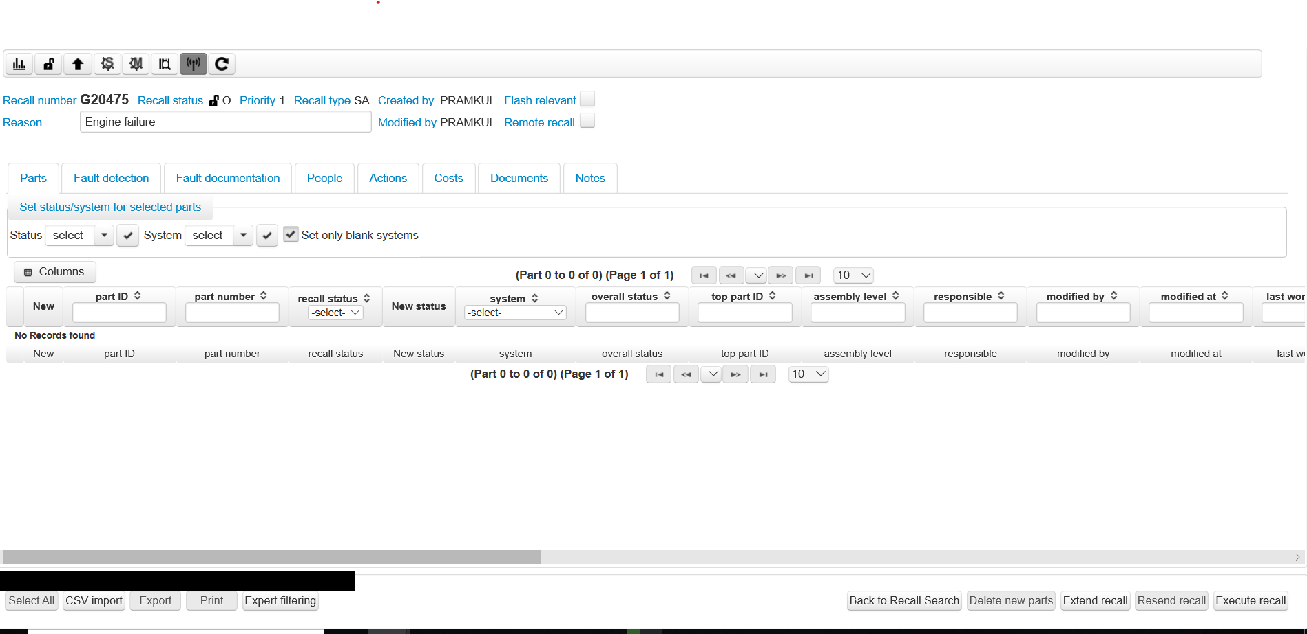
Click on Extend recall to add parts
.
Click on extend recall and Add parts to recall.

Slide 22
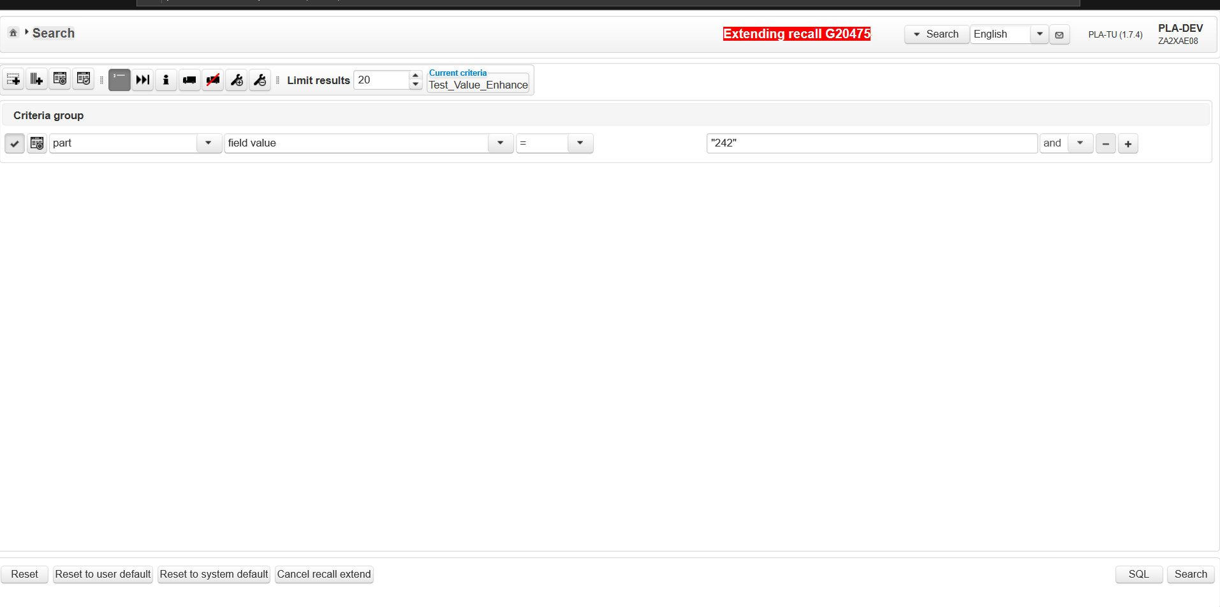
Click on Extend recall to add parts
.
Search view page should be displayed and Recall number extending message should be displayed.
On Click of cancel recall extend ,Page should be redirected to Recall Management page

Slide 23
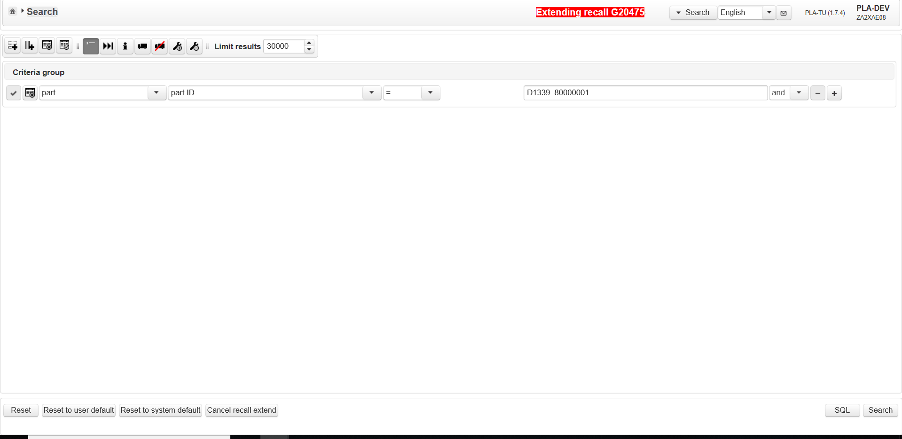
Select Criteria and Click Search button
.
Select Criteria Part –part ID= D1339 80000001
Click on Search button

Slide 24
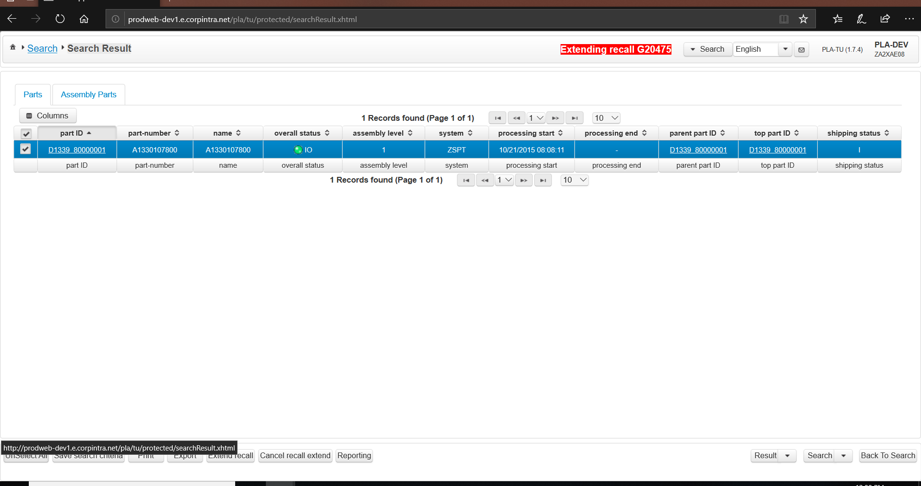
On Click Search button
.
Search Result Page is displayed and Extending message + recall number in red color should be displayed.
On Click of extend recall ,this part will be added to recall and on click of cancel recall extend, extend operation will be cancelled and recall Management page will be displayed

Slide 25
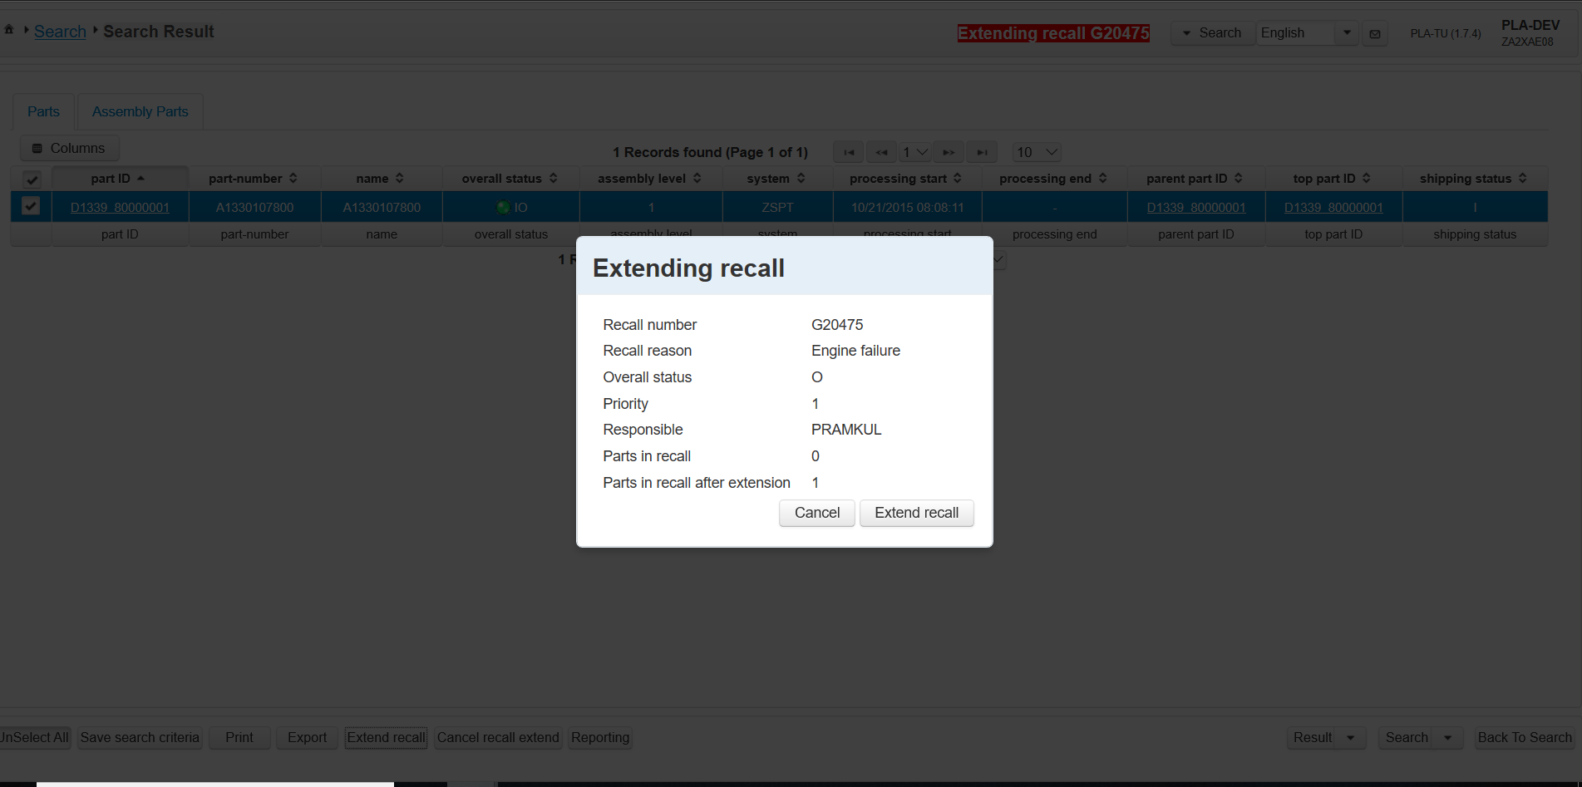
Click on Extend recall inside search result page
Extend recall dialog consists of recall number information and number parts present in the recall and number of parts once this part added to recall
.
On Click of extend recall ,Extend recall dialog will be displayed and it’s a modal dialog with background is disabled.
Click on Extend Recall button

Slide 26
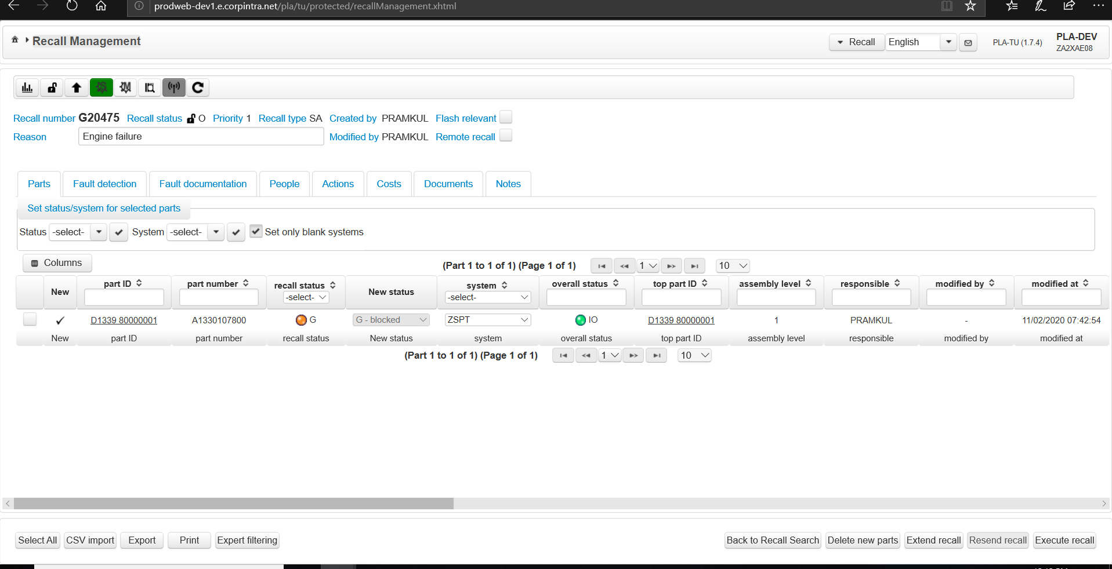
Click on Extend recall inside extend recall dialog
1.Recall Management page is displayed.
2. Unique number of records from parts tab and assembly tab are added.
3. All parts are added to top of the list and with new flag.
4. All parts are blocked (Status=G) and orange in color.
.
Delete new parts button is enabled now. On Click of that, part which is added now will be deleted from the recall number G20475.

Slide 27
Click on Extend recall again when part is in new state
.
Click on extend recall again when part is in new state(Recall is executed).

Slide 28
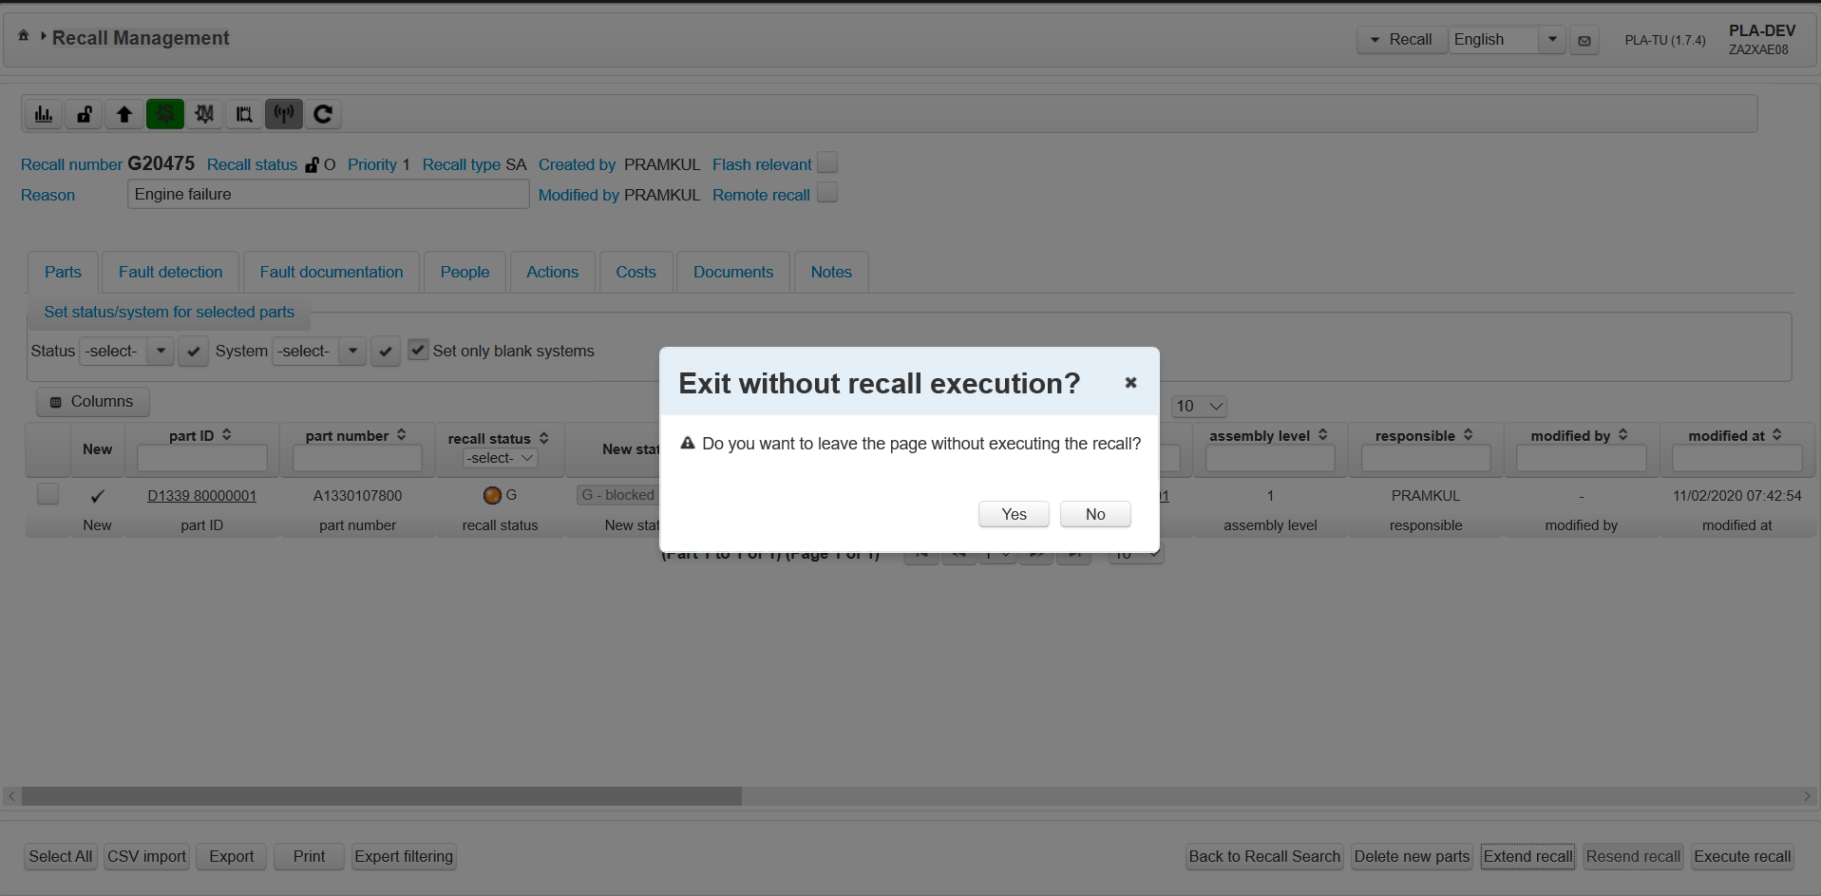
Extend recall alert dialog
.
Exit without recall execution ? Dialog is displayed and which is a modal dialog, click on yes button will navigate to Search view and parts can be added using extend recall operation and on click of no button will close the dialog .

Slide 29
Click on back to recall search/Home button
Or Click on home button
.
Click on Back to Recall Search.

Slide 30
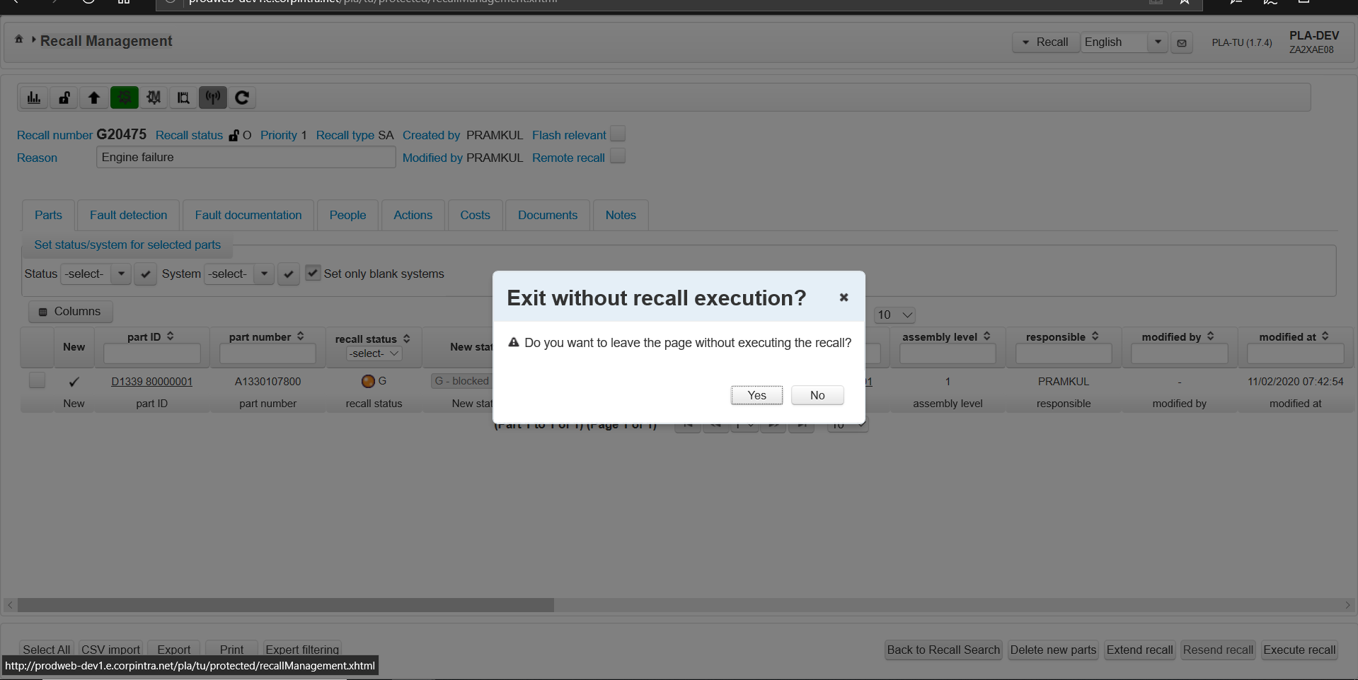
On Click of back to recall search/Home button
Exit without recall execution ? Dialog is displayed and which is a modal dialog, click on yes button will navigate to Recall Overview page.

Slide 31
Click on execute recall button
.
Click on Execute recall button

Slide 32
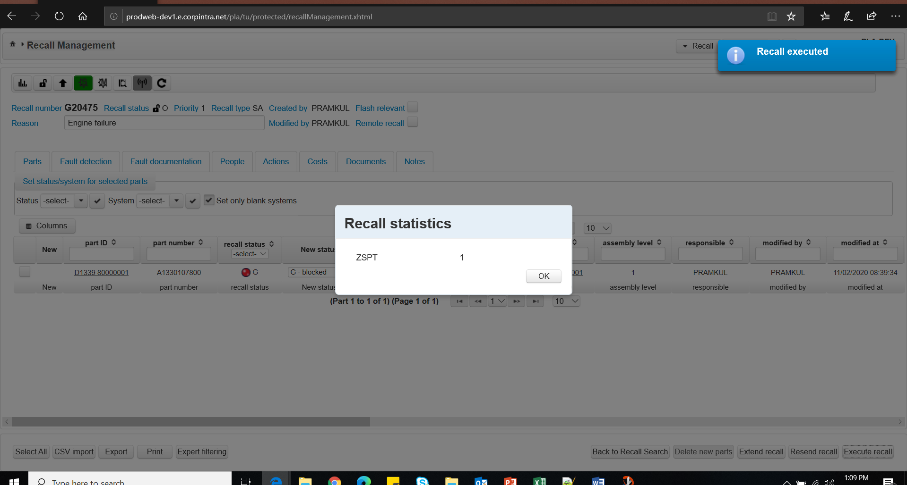
On Click of Execute recall button
.
After successful recall execution ,Recall executed growl message is displayed.
Recall Statistics dialog is displayed after execute recall. Once recall is execute respective systems and stations are notified for that part recall is executed and entry is created in DB.

Slide 33
Recall Execution
1.Recall is executed Growl message is displayed on recall successful execution
2.Recall statistics window giving information about the number of parts that have been changed as well as the systems that have been affected, should be displayed.
Ex.ZSPT=1
Note: For few systems recall statistics window is not shown
3. Status columns values are enabled now.
4. Orange color is changed to Red for status.
5.PLA user can unblock the parts now by changing the status.
6.Data is persisted into Db on executed recall.
7. ATE_AKTION_TEMP is set to 0 for all parts after recall is executed.

Slide 34
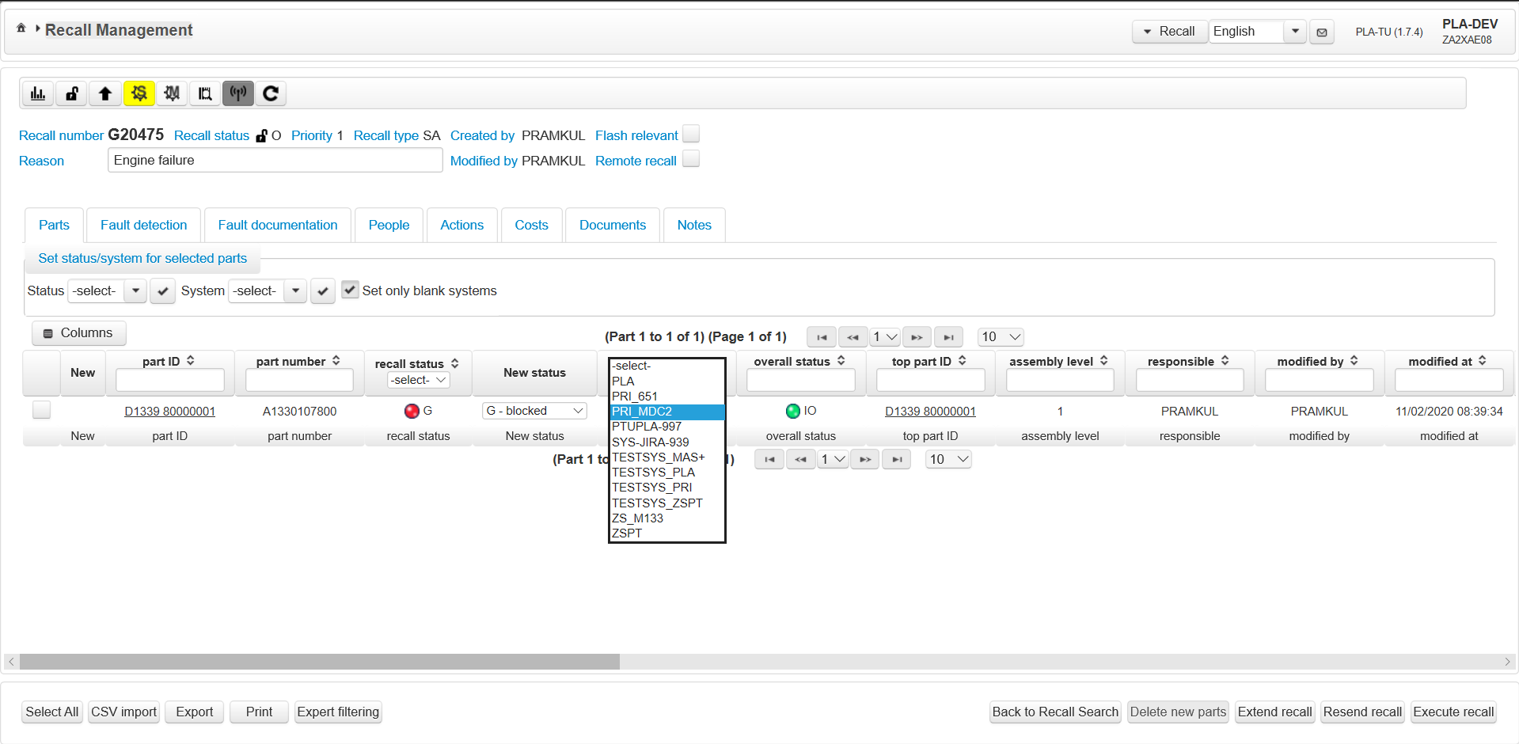
Change system from ZSPT to PRI_MDC2
Stations color is changed to yellow because PRI_MDC2 is not part of default stations list
.
Click on execute recall button
Change system from ZSPT to PRI_MDC2

Slide 35
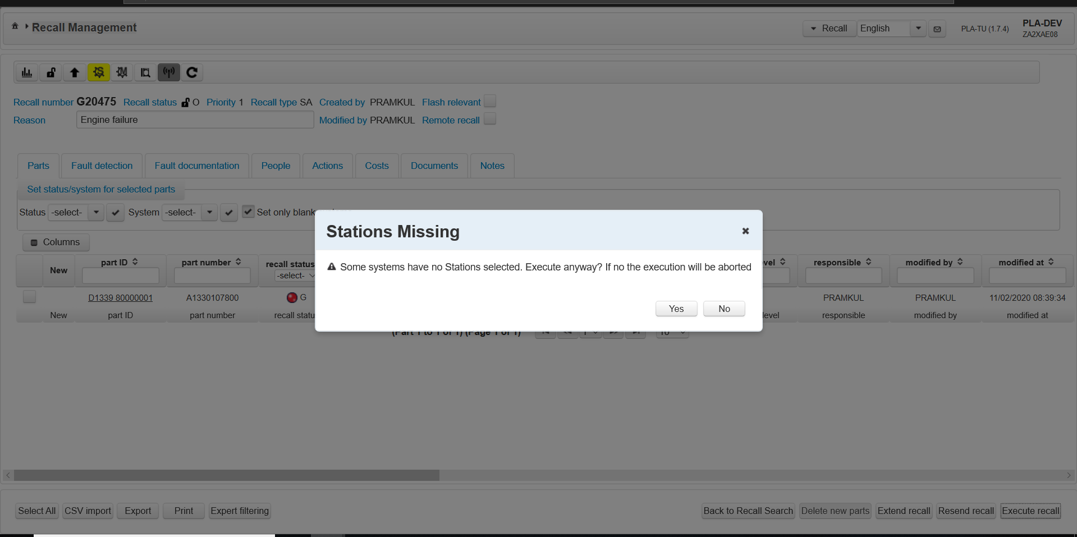
On Click of execute recall button when stations are missing
.
Stations missing confirmation dialog is displayed. On Click of yes button ,Stations are which are added to recall will be executed and rest wil be ignored. By default PLA system will be executed.
Click on No button.

Slide 36
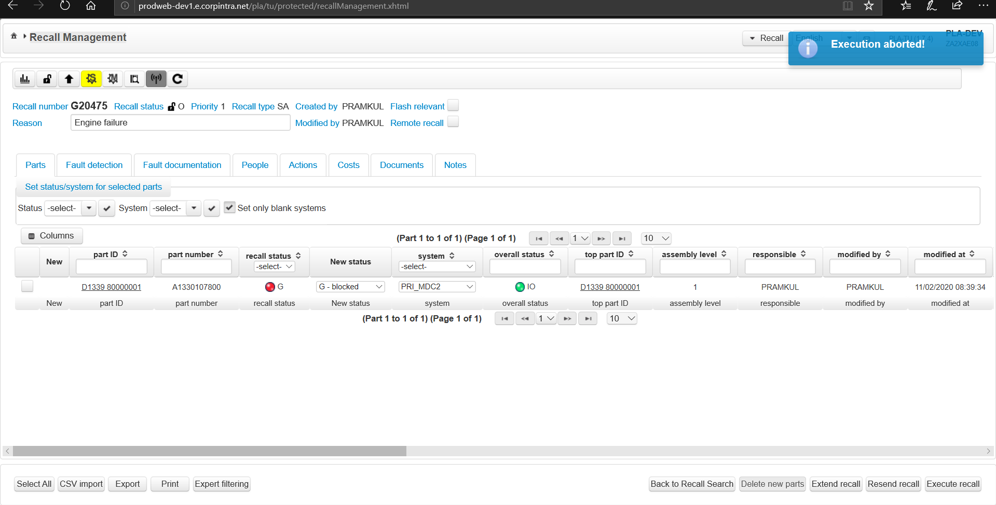
Click on Stations dialog
Click on Stations dialog.
.
Recall execution abort message on click of no button for stations missing dialog

Slide 37
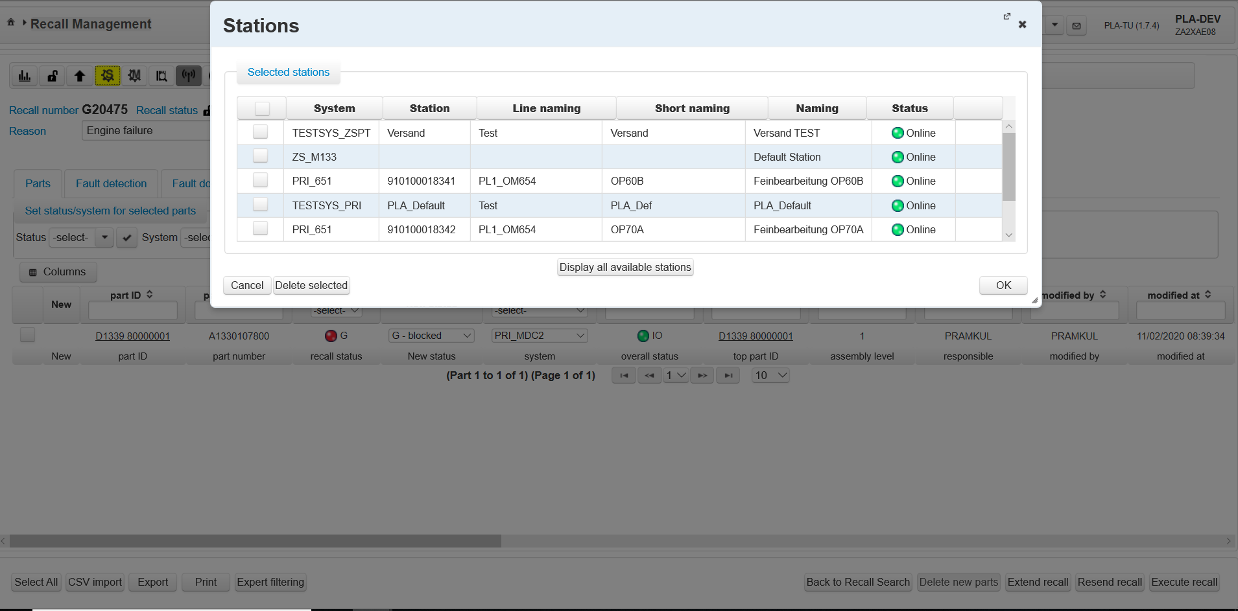
On Click of Stations dialog
.
When recall is created, set of default stations list is added to recall. This default stations list cannot be deleted
Click on Display all available stations

Slide 38
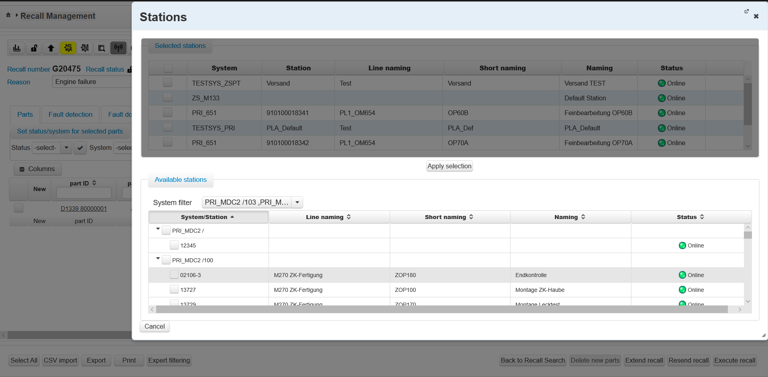
On Click of Display all available stations
.
Selected Stations list is disabled.
Using System filter PLA Recall user can filter particular system/station and can add to Selected stations list.
PLA Recall user has option to select System/Station by clicking on checkbox. When checkboxes are checked on parents node by default all child nodes are select and by clicking on Apply selection all nodes will added to Selected stations list,

Slide 39
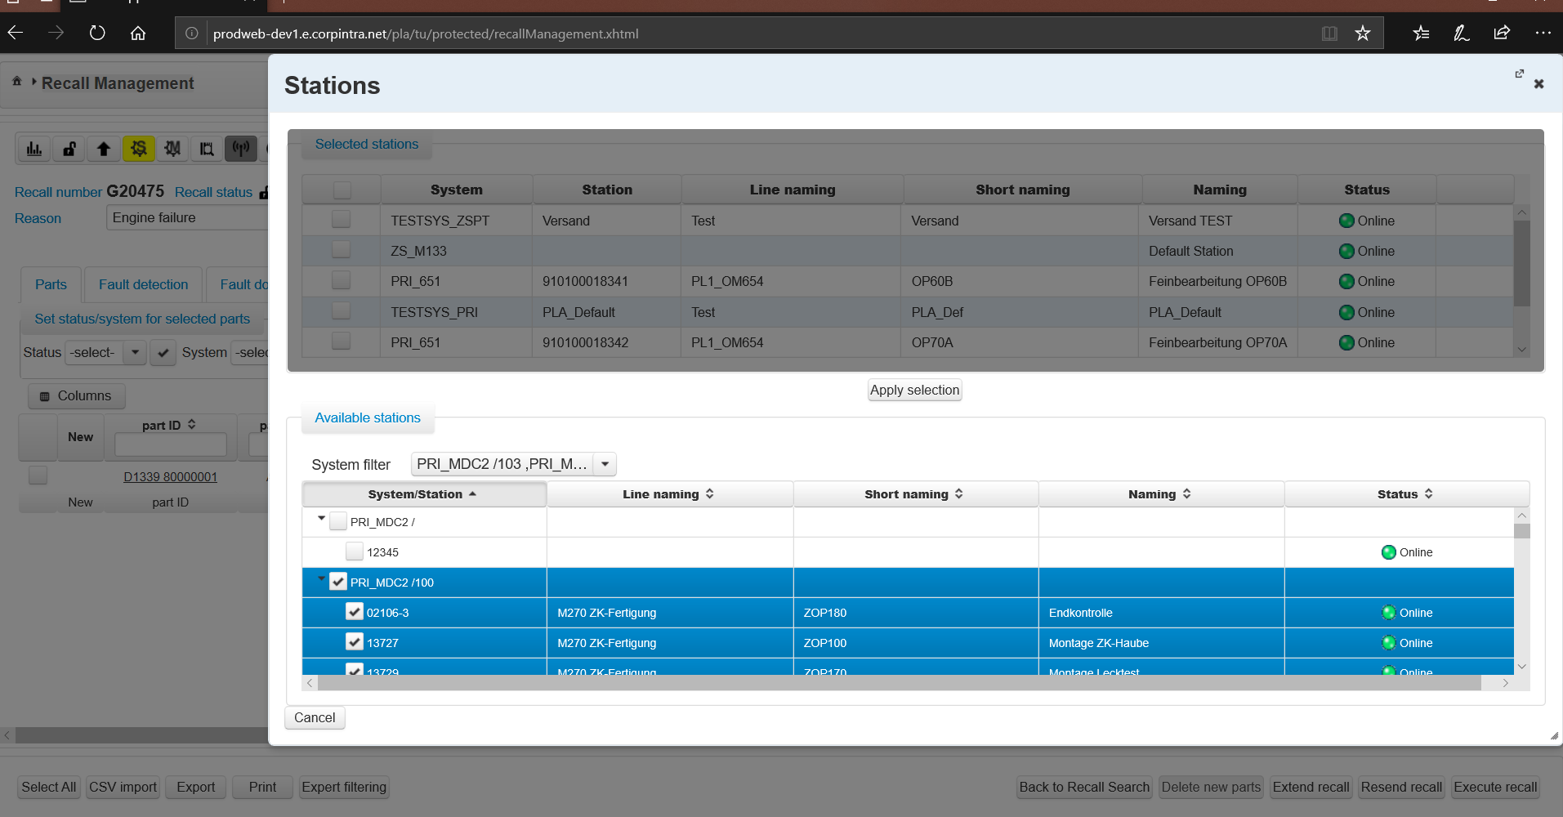
Selecting parent node
.
Click on Apply Selection button
Select PRI_MDC2/100 stations parent node, all corresponding child nodes will be added to selected stations list.

Slide 40
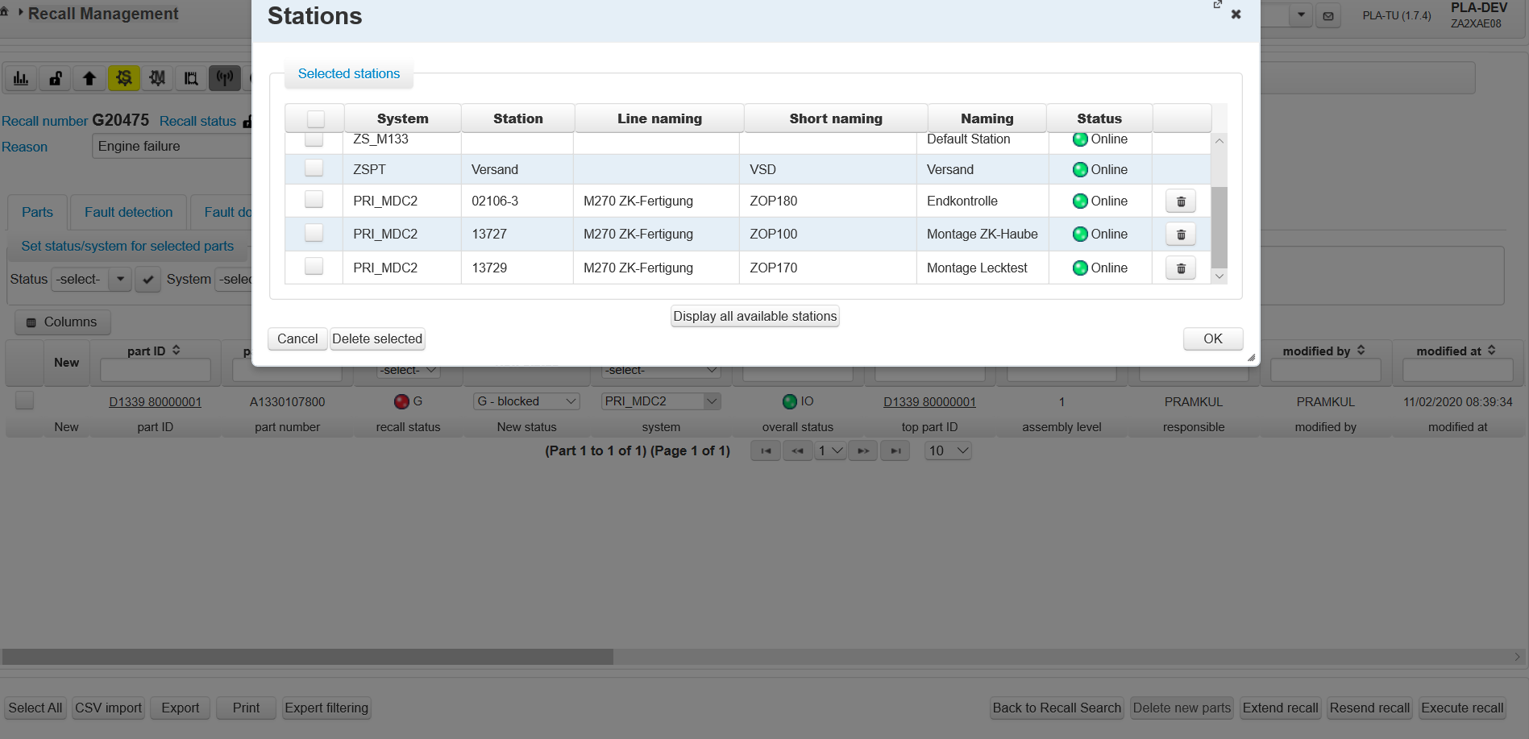
Change status and system for recall number B18722
.
Trash (Icon) delete button is enabled for recently added System/Stations to selected stations list
Click on Confirm button
Click on OK button.
Change Status from B to G

Slide 41
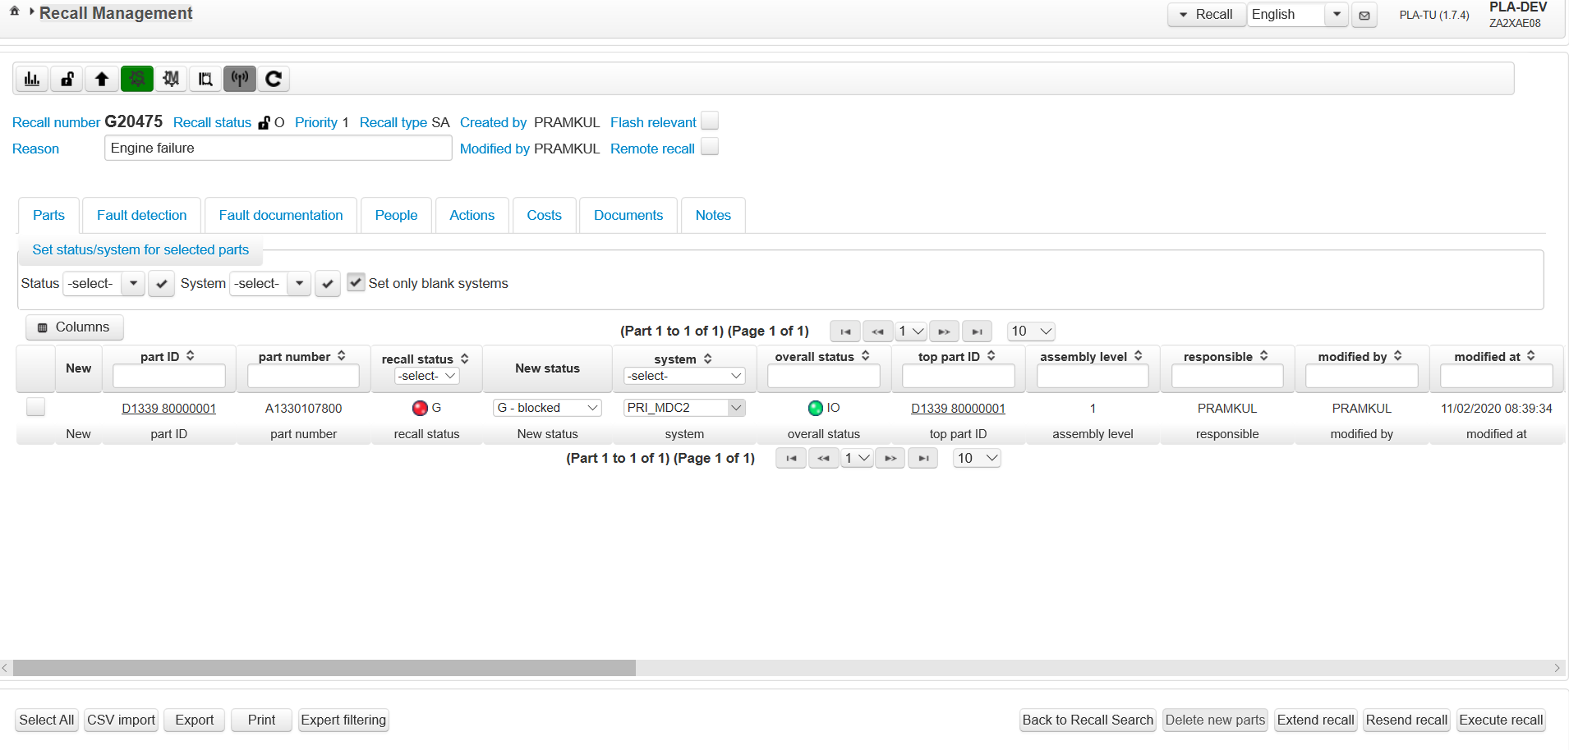
On Click of OK button inside Stations dialog
.
Stations color is changed to Green from yellow after adding PRI_MDC2 to selected stations list
Click on execute recall button

Slide 42
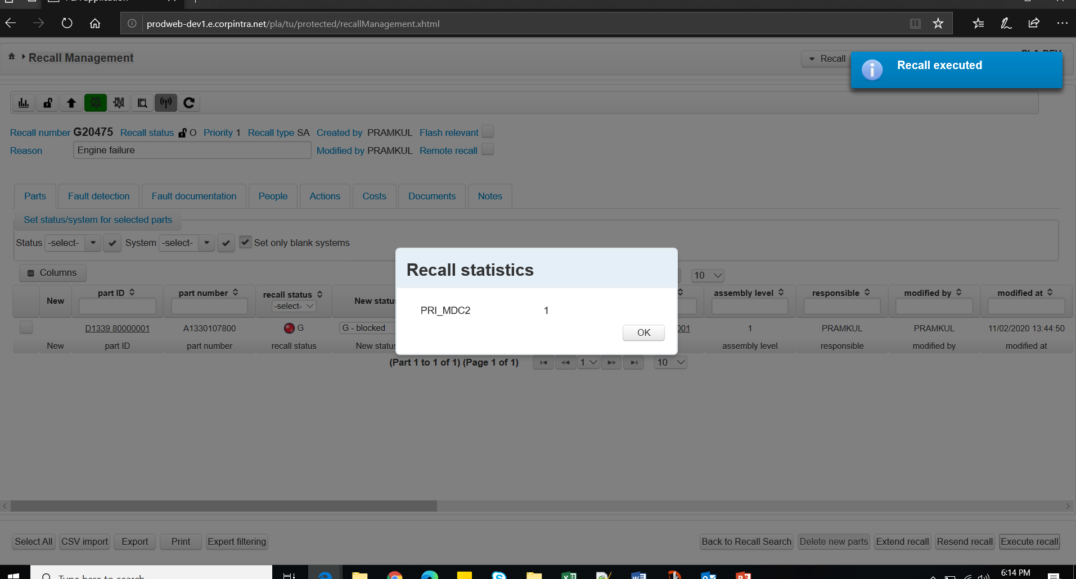
On Click of execute recall button
.
Recall is executed for PRI_MDC2 Sytem/Staion ,that system/station will be notified for the part D1339 80000001 recall is executed.

Slide 43
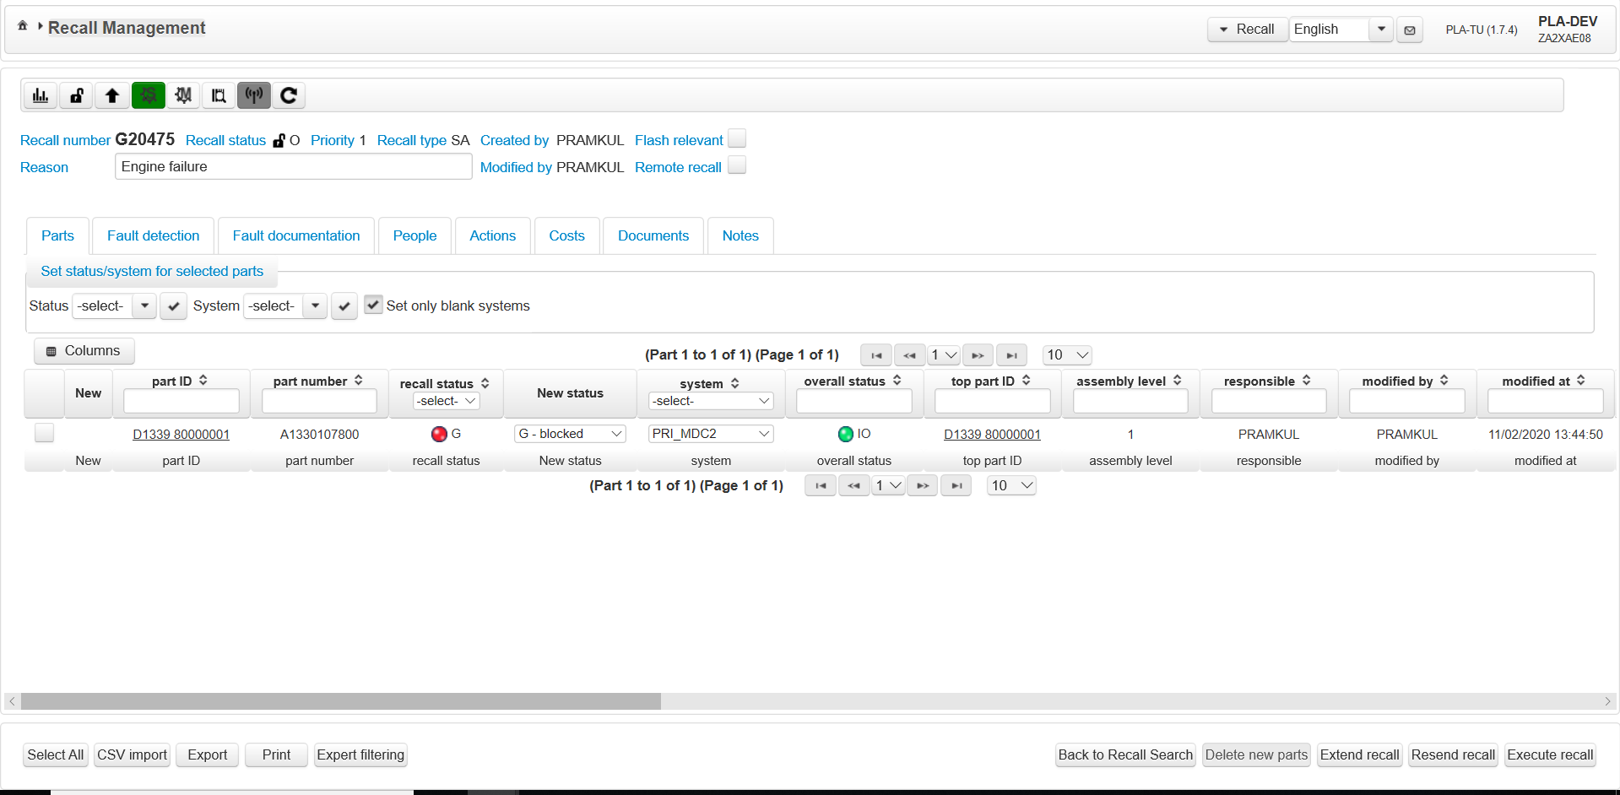
Click on recall Machines
.
Click on Recall Machines button. Initially no color will be displayed.

Slide 44
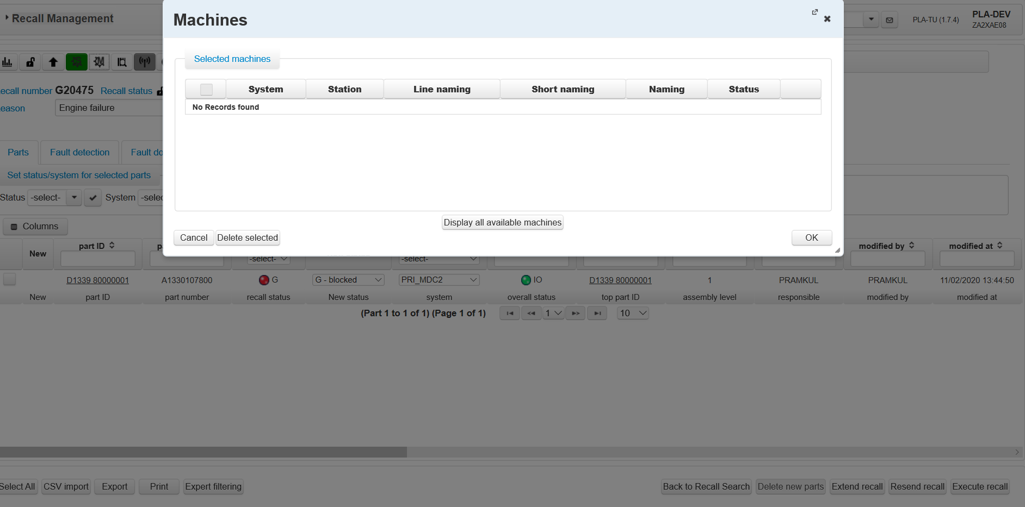
Click on recall Machines
.
Machines dialog is very similar to Stations dialog. But Machines doesn’t contain default machines and assigned recalls.
Delete Selected Machines button will delete machines on selected machines
On Click Display all available machines, all the available machines are displayed
Click on OK button will add machines to recall and Dialog will be closed.

Slide 45
Click on Display all Available Machines
.
Click on Display all available machines

Slide 46
Click on Display all Available Machines
.
Click on Display all available machines

Slide 47
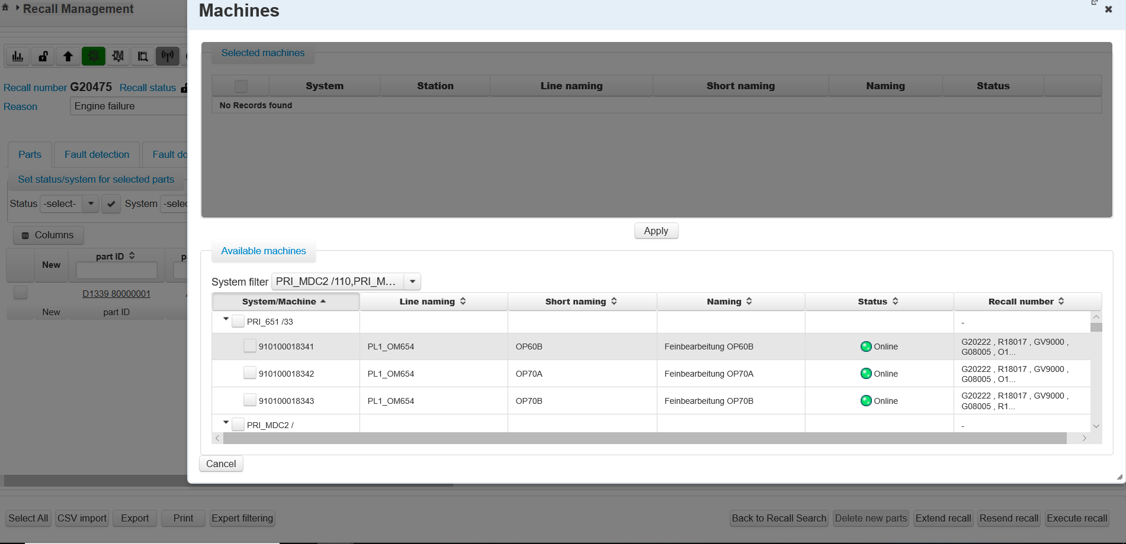
Click on Display all Available Machines
.
PLA Recall User can select available machines either by selecting parent node or child node

Slide 48
Recall Machines
When Status and System is changed and clicked on confirm button, Status and System should be updated for that recall number and stored in DB. Recall Statistics should be displayed with count value.
When Life cycle window is opened after Status and System change , Information should get updated in respective recall number. Expand accoridian to view the state, modified date and user.Entry should get created in chronology arranged based on date (Ascending order)“.
Print preview must reflect the updated data of recall number. Part Overview and "Recall Information " to be displayed with same data . Data should match.

